Slide 1
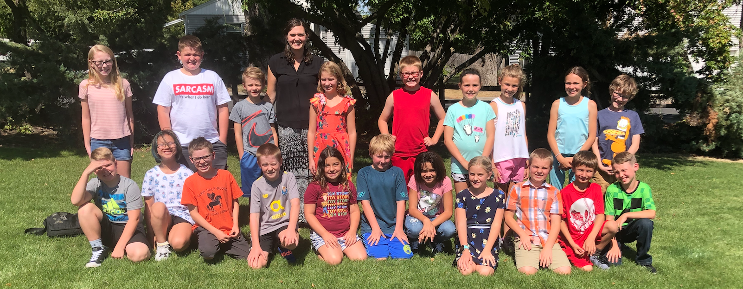
5th Grade Parent Night
z

Slide 2
Our Purpose Today
Get an overview of 5th grade
Outline your child’s responsibilities as a 5th grader.
Identify ways you can help your child stay on track.

Slide 3
ClassRoom Rules
Be safe
Be Respectful
Be Responsible
“You can do whatever you want as long as it doesn’t cause a problem for yourself or another person”

Slide 4
Class Schedule
8:15- 8:20 Attendance/Lunch count
8:20 – 9:05 PE/Music
9:05 – 10:30 Math
10:30 – 10:45 Recess
10:45 – 11:45 Reading/Language Arts
11:45 – 12:30 Lunch/Study Hall
12:30 – 1:15 Language Arts (+ Sound Off! on Th,
Imagine Math on W, and Library on T)
1:15 – 2:00 Social Studies
2:00 – 2:45 Science
2:45 -3:00 Choice and Accountability
*Reading Club meets M, T, Th, F from 12:40-1:10
*Extended Learning meets T/Th from 12:30-1:15

Slide 5
Mastery Learning
“Mastery based learning gives every child the opportunity to grow and succeed, to develop persistence and determination and it gives teachers the opportunity to meet individual students where they are”
Mastery based learning can look different from classroom to classroom.
Mastery based learning is built on the idea that every child can learn.

Slide 6
A note about 4’s! 4’s are very difficult to earn. Getting a 4 means that the student went above and beyond the 5th grade material we do in class and did well on that material.
Levels of Understanding
Level of Understanding | Description | Equivalent traditional grade | Potential Next Steps
Level 1: | Even with help, I don’t understand. | D or lower | Request tutoring from a teacher or friend, fix mistakes, find extra practice.
Level 2: | I’m starting to understand but I still need help or an example.. | C | Fix mistakes and find some extra practice with this skill.
Level 3: | I can do this on my own. I can show that I understand. | A or B | Either keep practicing this skill or move on to more challenging complex material.
Level 4: | I got this! I can use what I know to do something more complex | Beyond | Great work! Keep challenging yourself and seeking out new things to learn.

Slide 7
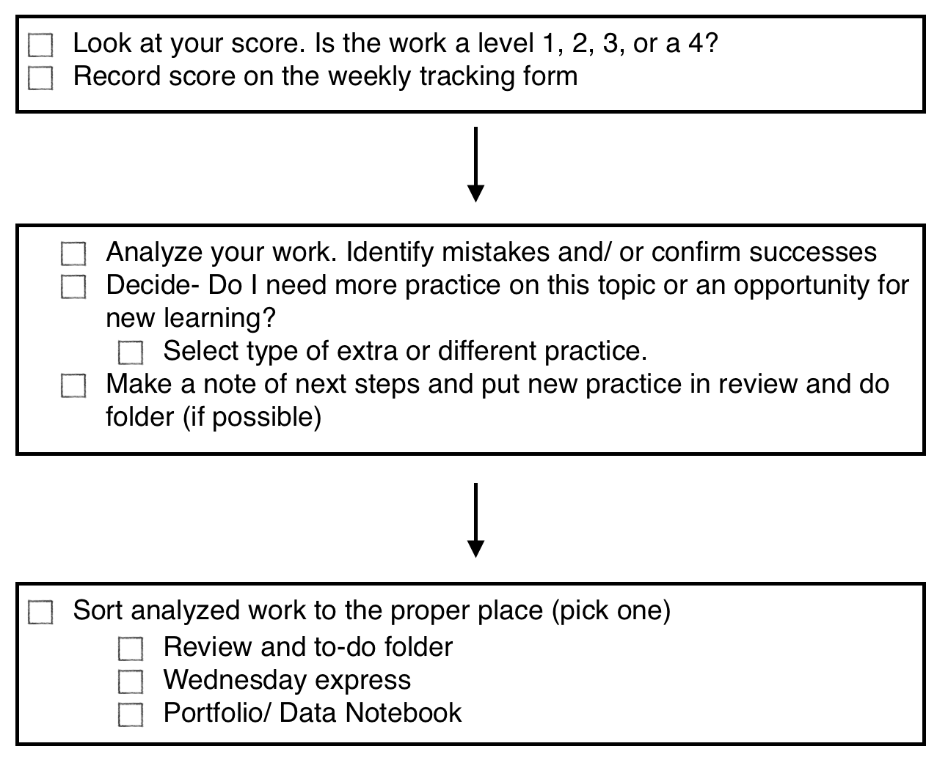
What does this mean for your child?
Students are responsible for tracking their scores, analyzing mistakes and then making a choice about what to do next on daily basis.

Slide 8
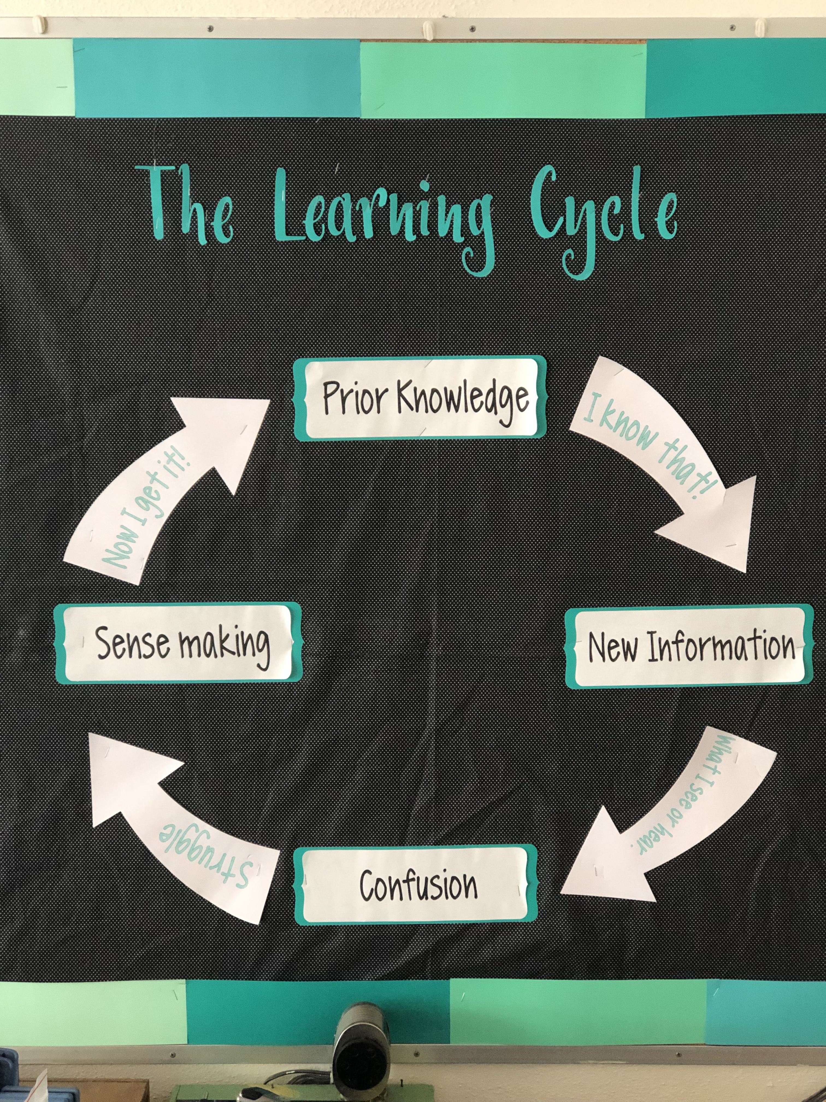
How to support your child
Watch for assignments to come home. Have a conversation with them about their work.
Ask about what they did for math minutes (next steps).
Ask about “fix me’s” or second tries
Watch for the Weekly Update for missing assignments and progress towards mastery.
Support the idea that struggle is normal, it’s what you do about it that matters.

Slide 9
How will I know what my child’s grades are?
Progress reports mid-quarter
Stay Tuned for our new reporting and grading system “TeacherEase”

Slide 10
What About Homework?
Homework should support the learning that is happening at school. With that in mind, your child may bring home any of the following types of homework.
Reading
Work that was unfinished at school
Extra practice or challenge work
Special projects

Slide 11
Unfinished Work
Students are provided with many opportunities to complete their work at school and most students are able to do so. In the case that students are unable to finish their work in class it will become homework.
Typical types of work that might home are math practice sets, reading work, unfinished writing and assignments from science or social studies.
Please check the planner. Students are expected to check off completed work and highlight work that is unfinished. Sometimes they are not expected to complete the whole page and the number of problems is listed here as well.

Slide 12
Extra Practice or Challenge Work
Math minutes are our way of creating extra practice or challenge for students. We provide time for students to carry out this work during our daily choice and accountability time. Stay tuned (in the planner) for the weekly goal.
Students use MobyMax, Khan Academy, Zearn and/or other review and enrichment.
Please sign your child’s planner for Minutes completed at home.

Slide 13
Special Projects
Occasionally, we will have special projects that need to be completed outside of school. Information will be provided to students in advance and shared with parents in the planner.
Sound OFF
We will use informal debates to discuss current events/items of interest in a format called Sound Off! One Sound Off! is required each quarter.
Students have their 1st quarter dates in their planner.

Slide 14
Reading in 5th Grade
We have a 40 book challenge in 5th grade!
Students will be asked to read a variety of types of books to meet this goal.
I want your child to be reading books that are an appropriate challenge. Most books should be within your child’s ZPD, or zone of proximal development. (This is noted in your child’s planner.)
I expect students to read at home each night.

Slide 15
Free Fun Friday
All students who are caught up on their work for the week & have no behavior issues will have the opportunity to participate in Free Fun Friday!
During this time, students may have an extra recess, board games in the classroom, a math game, or other activities we deem appropriate.
Students who did not earn FFF time will have study hall time in class.

Slide 16
The BIG Deal Party
At the end of each quarter, children who:
have made progress with their reading goal
have less than five incomplete assignments
have no major behavior incidents
…will earn participation in the BIG DEAL Party. This special activity is chosen by the students, such as playing board or card games or watching a movie with popcorn, ice cream sundaes, floats, etc.
Students who haven’t made it to the Big Deal will have a Study Hall.

Slide 17
Home School Communication

Slide 18
Planners
On Monday, students glue in a copy of the planner. At the end of the day completed work should be checked off. Highlighted work is homework. This is intended to enhance communication between school and home so that parents can stay informed of daily classroom activities and homework.
On Wednesday please review and sign your child’s planner on Wednesday evenings.

Slide 19
Weekly Update
Each Wednesday your child will have a Weekly Update in their Wednesday folder. Please sign in the planner to confirm you have seen this.
Two very important parts of each Weekly Update is the Upcoming Events and the Weekly Learning Targets sections. Here you will find dates for important upcoming events at school and what content we have been working on for the past week.

Slide 20
WEBSITE
You can also find more information on the school website.
My page is linked under “parent resources”

Slide 21
5th Grade Highlights
Paradise Ridge Challenge Course
Student Council
2nd Grade Buddies
Science on Ice
Lower Granite Dam
Graduation

Slide 22
Questions?
z

